Slide 1
Transfer learning
Live sentiment analysis for market prediction

Slide 2

Why is it important
cheap
fast
lightweight
Questa foto di Autore sconosciuto è concesso in licenza da CC BY-NC-ND

Slide 3
question
Is it possible to achieve sufficient performances with less computing resources, memory and inference times?
Accuracy
Performance

Slide 4
objective
Starting model
Transfer learning
Efficiency

Slide 5
SIZE
ACCURACY
TEACHER
ACCURACY
SIZE
STUDENT

Slide 6
literature
Small BERT based models
Attention is all you need
Feature extraction
Fine tuning

Slide 7

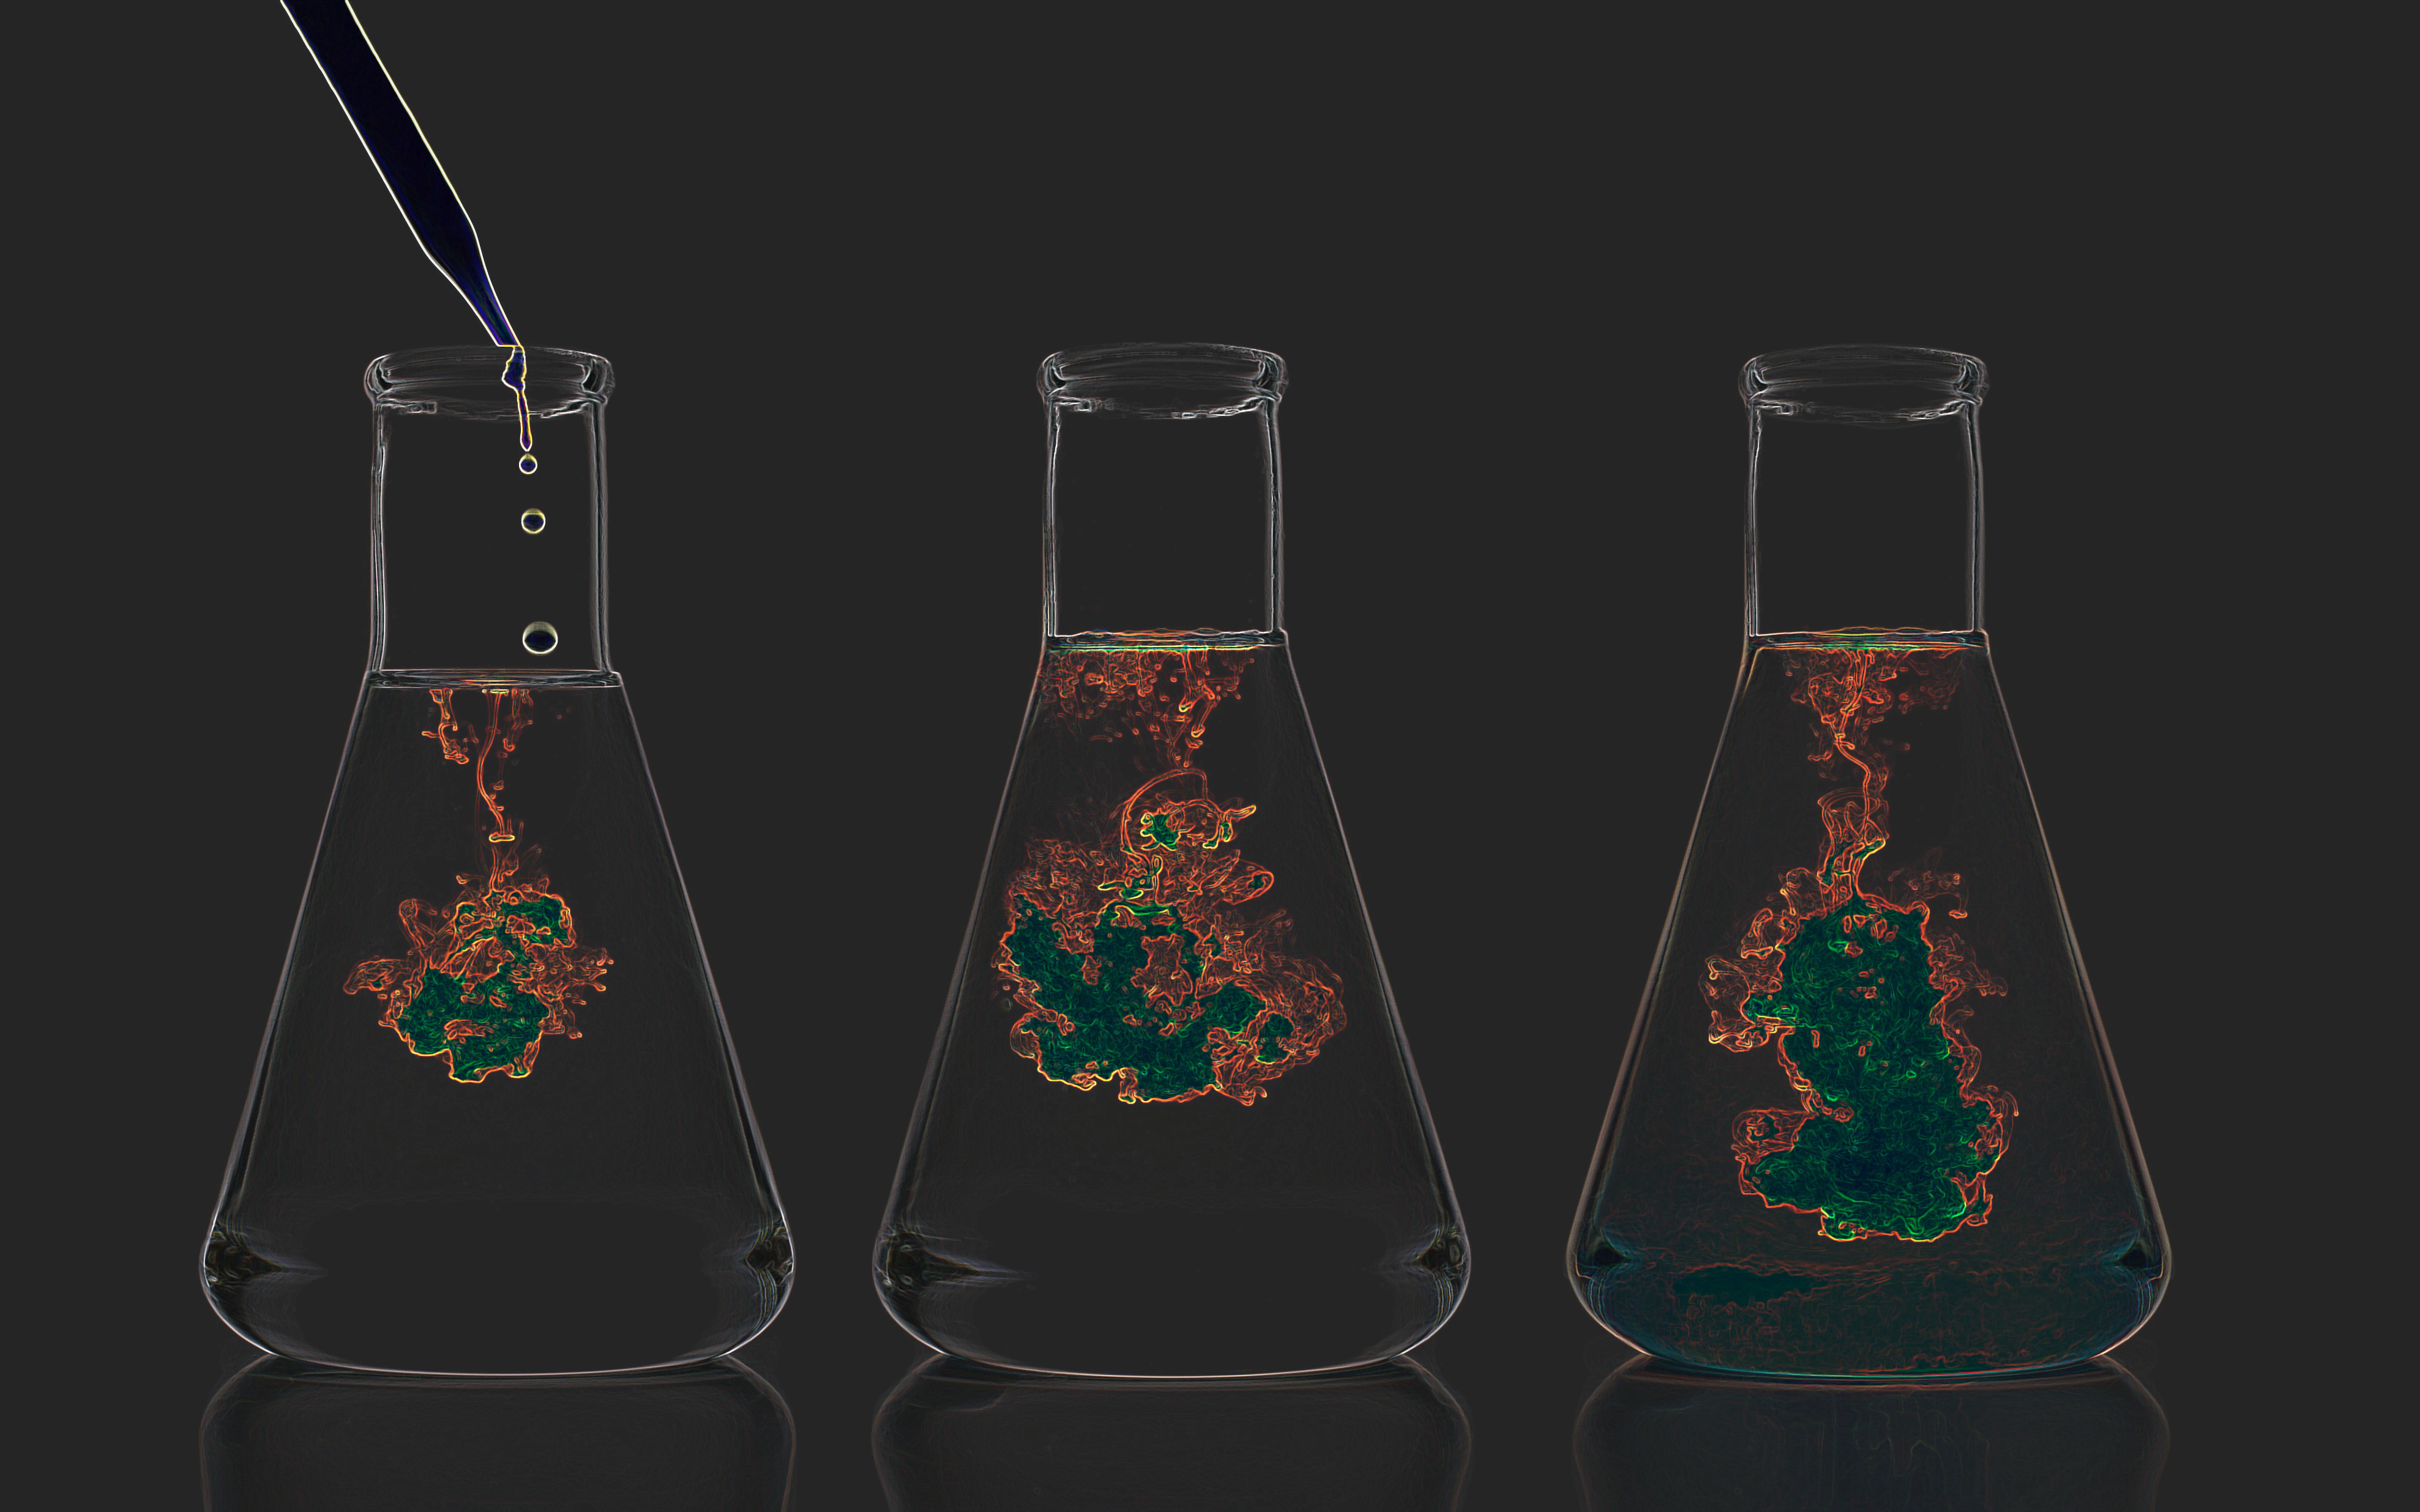
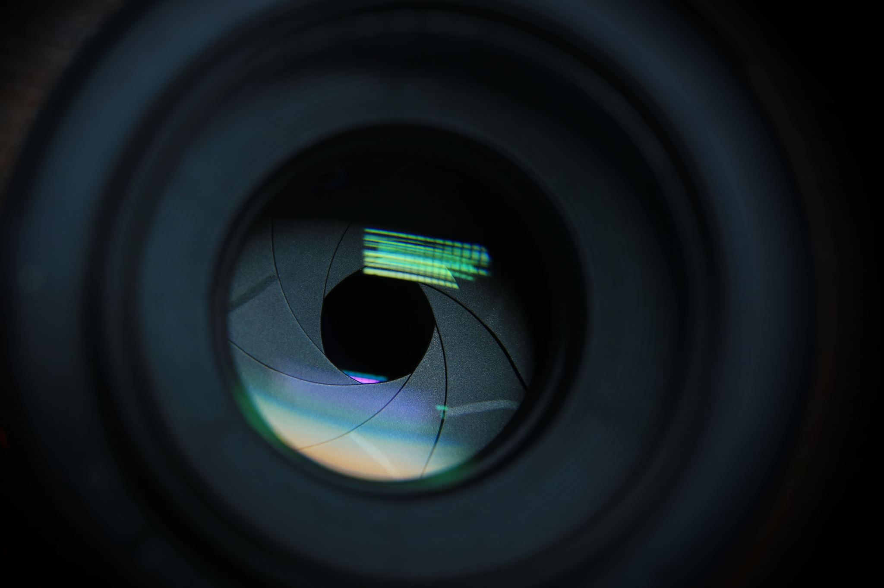
methodology
Quantitative
experimental
observation

Slide 8





Ethics
Questa foto di Autore sconosciuto è concesso in licenza da CC BY

Slide 9
Timeline and final artifact
Review
Testing
Tuned finalized model
Model choice

Slide 10
references
Aract D., (2019). FinBERT: Financial Sentiment Analysis with Pre-trained Language Models. University of Amsterdam. Available at: https://arxiv.org/pdf/1908.10063.pdf [Accessed: 22/03/2023]
Howard J. & Ruder S., (2018). Universal Language Model Fine-tuning for Text Classification. University of San Francisco, NUI Galway Aylien Ltd. Available at: https://arxiv.org/pdf/1801.06146.pdf [Accessed: 30/03/2023]
Huggingface, (2022). Distilgpt2. Huggingface. Available at: https://huggingface.co/distilgpt2 [Accessed: 25/03/2023]
Lacoste a. et al., (2019). Quantifying the Carbon Emissions of Machine Learning. Montreal University. Available at: https://arxiv.org/pdf/1910.09700.pdf [Accessed: 29/03/2023]
Mukul J. et al., (2021). Text Mining of Stocktwits Data for Predicting Stock Prices. MDPI Applied system innovation. Available at: https://arxiv.org/ftp/arxiv/papers/2103/2103.16388.pdf [Accessed: 30/03/2023]

Slide 11
references
Sanh V. et al., (2020). DistilBERT, a distilled version of BERT: smaller,
faster, cheaper and lighter. Huggingface. Available at: https://arxiv.org/pdf/1910.01108.pdf [Accessed: 29/03/2023]
University of Essex, (2020). Code of Good Research Practice. UoE. Available at: https://www.essex.ac.uk/governance-and-strategy/research-integrity [Accessed: 31/03/2023]
Vaswani A. et al., (2017) Attention is all you need. 31st Conference on Neural Information Processing Systems (NIPS 2017), Long Beach, CA, USA. Available at: https://arxiv.org/pdf/1706.03762.pdf [Accessed: 23/02/2023]
Xiaoqi J. et al., (2020). TinyBERT: Distilling BERT for Natural Language Understanding. Huawei Noah’s Ark Lab 3Huawei Technologies Co., Ltd. Available at: https://arxiv.org/pdf/1909.10351.pdf?trk=public_post_comment-text [Accessed: 25/03/2023]

